Slide 1

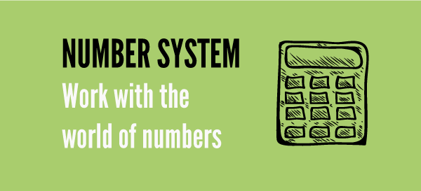
Number Systems

Slide 2

DIGITS
0 , 1 , 2 , 3 , 4 , 5 , 6 , 7 , 8 , 9
NUMERAL
A group of digits, denoting a number.
PEA302 Analytical Skills-II :: Vishal Ahuja

Slide 3
2 3 6 5
Th | H | T | O
2 | 3 | 6 | 5
PEA302 Analytical Skills-II :: Vishal Ahuja

Slide 4
TYPES OF NUMBERS
NATURAL NUMBER
1 , 2 , 3 , 4 , 5 . . .
WHOLE NUMBER
All natural numbers including 0.
INTEGERS
All natural numbers, 0 & negative numbers
{…, -3, -2, -1, 0, 1, 2, 3, …}
Positive Integers {1, 2, 3, …}
Negative Integers { -1, -2, -3, …}
Non-Positive & Non-Negative Integer is 0.
PEA302 Analytical Skills-II :: Vishal Ahuja

Slide 5
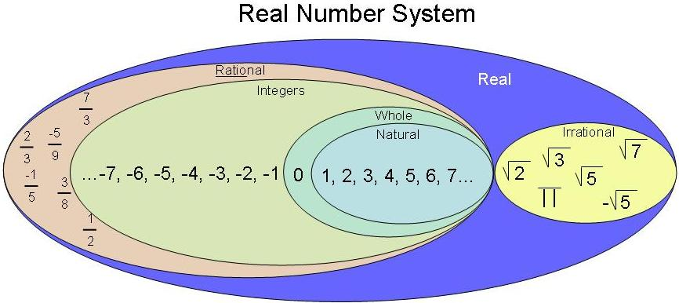
TYPES OF NUMBERS
PEA302 Analytical Skills-II :: Vishal Ahuja

Slide 6
EVEN & ODD NUMBERS
EVEN NUMBER
No’s divisible by 2.
ODD NUMBER
No’s not divisible by 2.
PEA302 Analytical Skills-II :: Vishal Ahuja

Slide 7
Facts about Even & Odd No’s
Sum / Difference of two even numbers is an even number.
Sum / Difference of two odd numbers is an even number.
Sum / Difference of an even number and an odd numbers is an odd number.
PEA302 Analytical Skills-II :: Vishal Ahuja

Slide 8
TYPES OF NUMBERS – Prime No
A Prime No is a natural no greater than 1 that has no positive divisors other than 1 and itself.
Prime no’s upto 100 are
2, 3, 5, 7, 11, 13, 17, 19, 23, 29, 31, 37, 41, 43, 47, 53, 59, 61, 67, 71, 73, 79, 83, 89, 97.
A natural number greater than 1 that is not a prime number is called a Composite No.
Two no’s a & b are said to be Co-Primes, if their HCF is 1.
PEA302 Analytical Skills-II :: Vishal Ahuja

Slide 9
Tests of Divisibility
A no is divisible by | If
2 | Unit’s digit is divisible by 2.
3 | Sum of its digits is divisible by 3.
4 | No formed by last 2 digits is divisible by 4.
5 | Unit’s digit is either 0 or 5.
6 | It is divisible by both 2 & 3.
7 | Eg 14 Double the unit digit i.e 8 subtract the remaining digit i.e 8-1 = 7 ans will be either 0 or multiple of 7
8 | No formed by last 3 digits is divisible by 8.
9 | Sum of its digits is divisible by 9.
10 | It ends with 0.
PEA302 Analytical Skills-II :: Vishal Ahuja

Slide 10
Tests of Divisibility
A no is divisible by | If
11 | The difference of sum of its digits at odd places and sum of its digits at even places, is either 0 or a no divisible by 11.
12 | It is divisible by both 3 & 4.
13 | Eg 26 Multiply unit digit by 4 i.e 6 X 4 = 24 add Other digit = 26 ans will be divisible by 13
14 | It is divisible by both 2 & 7.
15 | It is divisible by both 3 & 5.
16 | The number formed by last four digits is divisible by 16.
17 | Eg 34 Multiply unit digit by 5 e.g 4 X 5 =20 subtract the other digit i.e 20 – 3 = 17 ans will be divisible by 17.
18 | Number must be divisible by 9 & 2 both as 9 and 2 are co prime
19 | Eg 38 Multiply unit digit by 2 e.g 8 X 2 =16 add the other digit i.e 16+3 = 19 ans will be divisible by 19. .
PEA302 Analytical Skills-II :: Vishal Ahuja

Slide 11
Division Algorithm
Dividend = (Divisor * Quotient ) + Reminder
PEA302 Analytical Skills-II :: Vishal Ahuja

Slide 12
Basic Formulae
(a + b)(a - b) = (a² - b²)
(a + b)² = (a² + b² + 2ab)
(a - b)² = (a² + b² - 2ab)
(a + b + c)² = a² + b² + c² + 2(ab + bc + ca)
(a³ + b³) = (a + b)(a² - ab + b²)
(a³ - b³) = (a - b)(a² + ab + b²)
(a³ + b³ + c³ - 3abc) = (a + b + c)(a² + b² + c² - ab - bc - ac)
When a + b + c = 0, then a³ + b³ + c³ = 3abc.
PEA302 Analytical Skills-II :: Vishal Ahuja

Slide 13
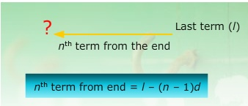
ARITHMATIC PROGRESSION
An Arithmetic Progression (A.P.) is a sequence in which the difference between any two consecutive terms is constant.
Let a = first term, d = common difference
Then nth term
PEA302 Analytical Skills-II :: Vishal Ahuja

Slide 14


Sum of an A.P.
PEA302 Analytical Skills-II :: Vishal Ahuja

Slide 15
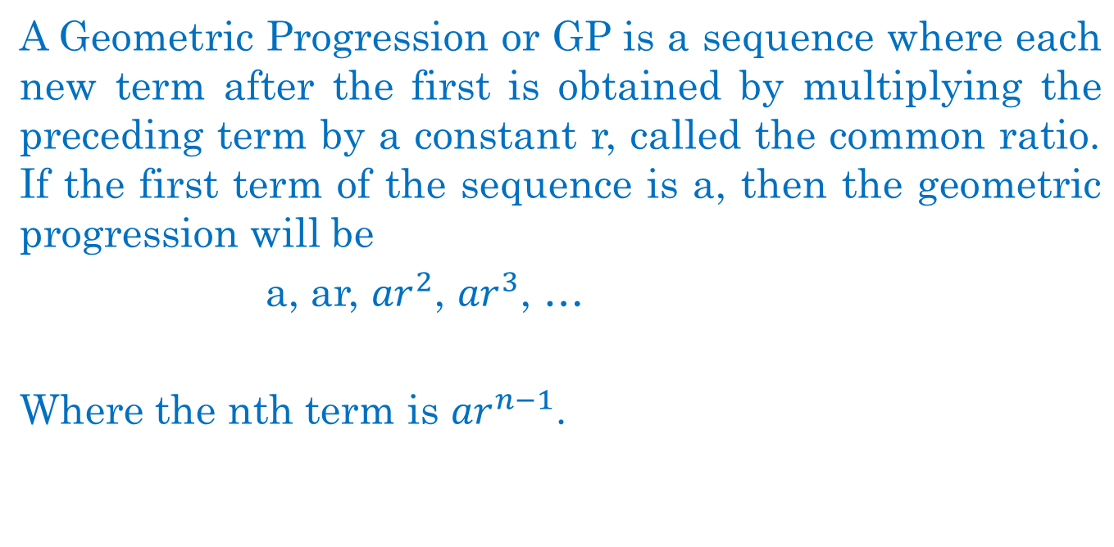
GEOMETRICAL PROGRESSION
PEA302 Analytical Skills-II :: Vishal Ahuja

Slide 16
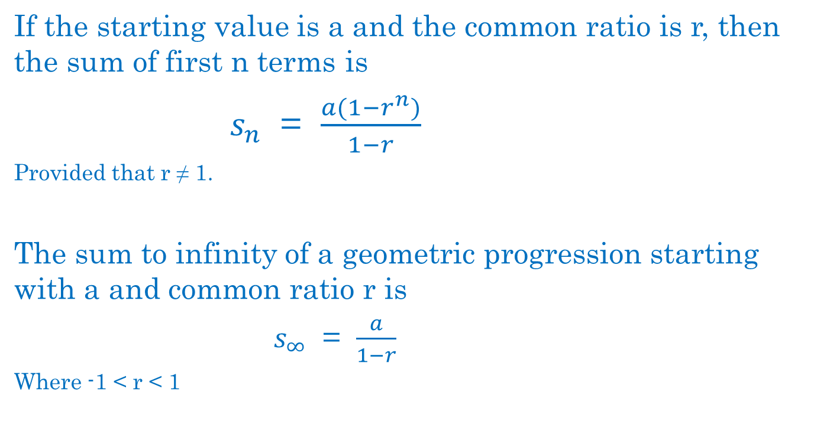
GEOMETRICAL PROGRESSION
S_{n} = a( r^{n} - 1) / r-1
If r > 1
PEA302 Analytical Skills-II :: Vishal Ahuja

Slide 17
HOW TO FIND THE CYCLICITY OF A NUMBER
FOR eg NUMBER IS 2
2 ¹ = 2 Unit Digit = 2
2 ² = 4 Unit Digit = 4
2 ³ = 8 Unit Digit = 8
2 ⁴ = 16 Unit Digit = 6 This cycle of unit digits will repeat itself after every 4 intervals so cyclicity of number 2 is 4 . Similarly cyclicity of number 9 is 2
PEA302 Analytical Skills-II :: Vishal Ahuja

Slide 18
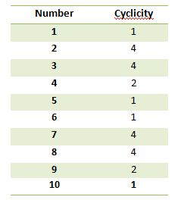
HOW TO FIND THE UNIT DIGIT OF A NUMBER
Cyclicity
PEA302 Analytical Skills-II :: Vishal Ahuja

Slide 19
Question
Find the unit digit of
2⁹⁵
PEA302 Analytical Skills-II :: Vishal Ahuja

Slide 20
Solution
The cyclicity of 2 is 4.
2¹ = 2
2² = 4
2³ = 8
2⁴ = 16
Divide 95 by 4. Remainder is 3.
So, the unit digit is 8.
PEA302 Analytical Skills-II :: Vishal Ahuja

Slide 21
Practice
The largest 4 digit number exactly divisible by 88 is:
A. 9944
B. 9768
C. 9988
D. 8888
E. None of these
PEA302 Analytical Skills-II :: Vishal Ahuja

Slide 22
Solution
Answer: Option A
Explanation:
Largest 4-digit number = 9999
Reminder of 9999 / 88 = 55
Required number = (9999 - 55) = 9944.
PEA302 Analytical Skills-II :: Vishal Ahuja

Slide 23

Practice
Find the unit digit of
9⁹⁹
Quick yak:
Use concept
of Q 1.4
PEA302 Analytical Skills-II :: Vishal Ahuja

Slide 24
Solution
The cyclicity of 9 is 2.
9¹ = 9
9² = 81
Divide 99 by 2. Remainder is 1.
So, the unit digit is 9.
PEA302 Analytical Skills-II :: Vishal Ahuja

Slide 25
Next Class: HCF & LCM
PEA302 Analytical Skills-II :: Vishal Ahuja

Slide 26
Factors and Multiples:
If number a divided another number b exactly, we say that a is a factor of b.
In this case, b is called a multiple of a.
PEA302 Analytical Skills-II :: Vishal Ahuja

Slide 27
Highest Common Factor (H.C.F.) or
Greatest Common Measure(G.C.M.) or Greatest Common Divisor (G.C.D.)
The H.C.F. of two or more than two numbers is the greatest number that divided each of them exactly.
Now, Suppose we have to find the H.C.F. of three numbers, then,
H.C.F. of three numbers = H.C.F. of [(H.C.F. of any two) and (the third number)]
Similarly, the H.C.F. of more than three numbers may be obtained.
PEA302 Analytical Skills-II :: Vishal Ahuja

Slide 28
Least Common Multiple (L.C.M.)
The least number which is exactly divisible by each one of the given numbers is called their L.C.M.
PEA302 Analytical Skills-II :: Vishal Ahuja

Slide 29
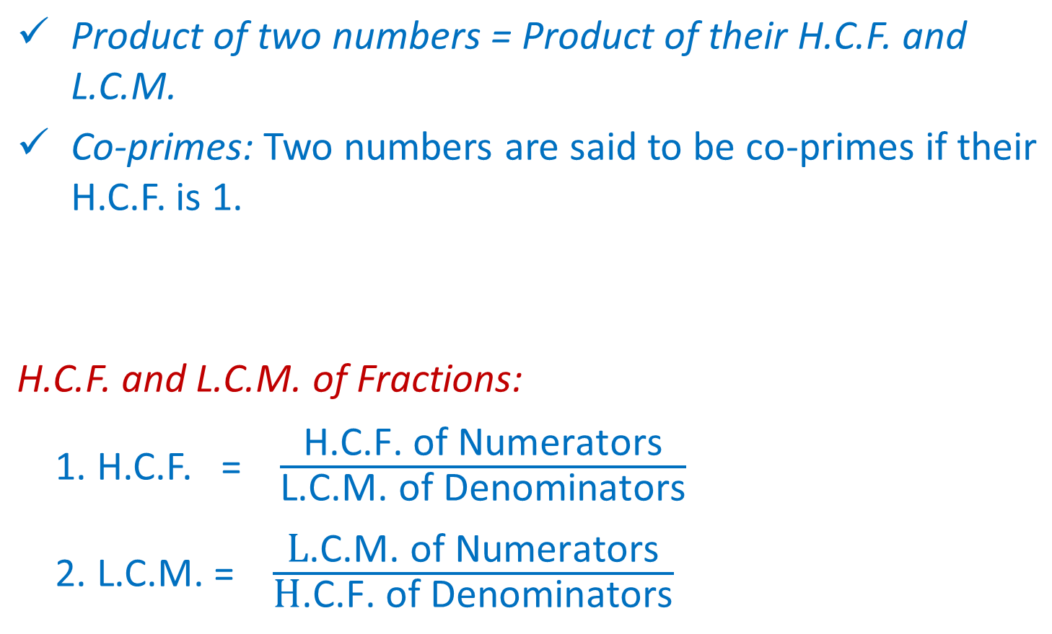
PEA302 Analytical Skills-II :: Vishal Ahuja

Slide 30
HCF and LCM Problem Solving
How can you tell if a word problem requires you to use Highest Common Factor or
Least Common Multiple to solve?
PEA302 Analytical Skills-II :: Vishal Ahuja

Slide 31
Q 2.1 : HCF Example
Samantha has two pieces of cloth. One piece is 72 inches wide and the other piece is 90 inches wide. She wants to cut both pieces into strips of equal width that are as wide as possible. How wide should she cut the strips?
PEA302 Analytical Skills-II :: Vishal Ahuja

Slide 32
Samantha has two pieces of cloth. One piece is 72 inches wide and the other piece is 90 inches wide. She wants to cut both pieces into strips of equal width that are as wide as possible. How wide should she cut the strips?
The pieces of cloth are 72 and 90 inches wide.
How wide should she cut the strips so that they are the largest possible equal lengths.
PEA302 Analytical Skills-II :: Vishal Ahuja

Slide 33
Samantha has two pieces of cloth. One piece is 72 inches wide and the other piece is 90 inches wide. She wants to cut both pieces into strips of equal width that are as wide as possible. How wide should she cut the strips?
This problem can be solved using Highest Common Factor because we are cutting or “dividing” the strips of cloth into smaller pieces (factor) of 72 and 90.
Find the HCF of 72 and 90
PEA302 Analytical Skills-II :: Vishal Ahuja

Slide 34
HCF Word Problem Solution
2 l 72 2 l 90
2 l 36 3 l 45
2 l 18 3 l 15
3 l 9 5 l 5
3 l 3 1
1
72 = 2 x 2 x 2 x 3 x 3
90 = 2 x 3 x 3 x 5
HCF = 2 x 3 x 3 = 18
Samantha should cut each piece to be 18 inches wide
PEA302 Analytical Skills-II :: Vishal Ahuja

Slide 35
If it is an LCM Problem
What is the question asking us?
Do we have an event that is or will be repeating over and over?
Will we have to purchase or get multiple items in order to have enough?
Are we trying to figure out when something will happen again at the same time?
PEA302 Analytical Skills-II :: Vishal Ahuja

Slide 36
: LCM Example
Ben exercises every 12 days and Isabel every 8 days. Ben and Isabel both exercised today. How many days will it be until they exercise together again?
PEA302 Analytical Skills-II :: Vishal Ahuja

Slide 37
Ben exercises every 12 days and Isabel every 8 days. Ben and Isabel both exercised today. How many days will it be until they exercise together again?
Ben exercises every 12 days and Isabel every 8 days and they both exercised today.
How many days is it until they will both exercise on the same day again.
PEA302 Analytical Skills-II :: Vishal Ahuja

Slide 38
Ben exercises every 12 days and Isabel every 8 days. Ben and Isabel both exercised today. How many days will it be until they exercise together again?
This problem can be solved using Least Common Multiple. We are trying to figure out when will be the next time they are exercising together.
Find the LCM of 12 and 8.
PEA302 Analytical Skills-II :: Vishal Ahuja

Slide 39
LCM Word Problem Solution
2 l 12 2 l 8
2 l 6 2 l 4
3 l 3 2 l 2
1 1
12 = 2 x 2 x 3
8 = 2 x 2 x 2
LCM = 2 x 2 x 2 x 3 = 24
Ben and Isabel would exercise on the same day every 24 days.
PEA302 Analytical Skills-II :: Vishal Ahuja

Slide 40
Practice
Rosa is making a game board that is 16 inches by 24 inches. She wants to use square tiles. What is the largest size tile she can use?
PEA302 Analytical Skills-II :: Vishal Ahuja

Slide 41
Practice
2 l 16 2 l 24
2 l 8 2 l 12
2 l 4 2 l 6
2 l 2 3 l 3
1 1
16 = 2 x 2 x 2 x 2
24 = 2 x 2 x 2 x 3
HCF = 2 x 2 x 2 = 8
The largest size tile that Rosa can use is tile of 8 inches.
PEA302 Analytical Skills-II :: Vishal Ahuja

Slide 42
Practice
Two bikers are riding a circular path. The first rider completes a round in 12 minutes. The second rider completes a round in 18 minutes. If they both started at the same place and time and go in the same direction, after how many minutes will they meet again at the starting point?
PEA302 Analytical Skills-II :: Vishal Ahuja

Slide 43
Practice
2 l 12 2 l 18
2 l 6 3 l 9
3 l 3 3 l 3
1 1
12 = 2 x 2 x 3
18 = 2 x 3 x 3
LCM = 2 x 3 x 2 x 3 = 36
Both bikers will meet after 36 minutes.
PEA302 Analytical Skills-II :: Vishal Ahuja

Slide 44

Next Class Averages

